Slide 1
Team106online
Sprint 6

Slide 2
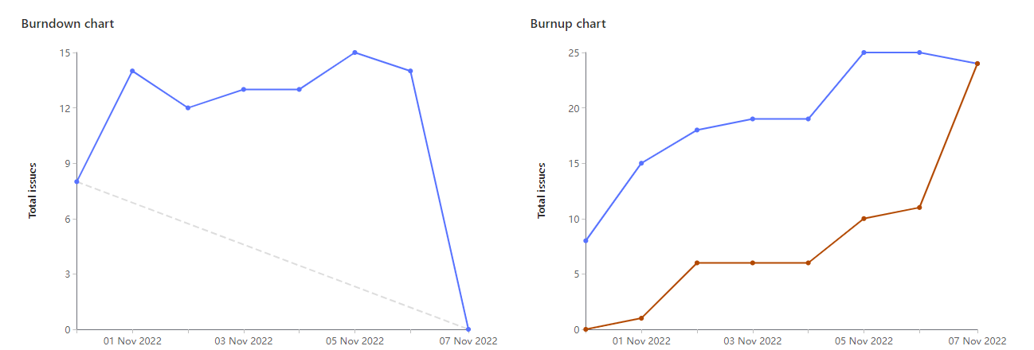
Sprint Progress

Slide 3
What Went Well
What To be Done Differently
Many pair programming sessions
Lots of collaboration on design
Schedule meetings more often (daily scrum)
More collaboration between subgroups

Slide 4
Team Member: Parker Carnegie
Work Highlights:
Total Weights: 23
Helped design calendar page in FIgma with Caleb and Muhammed
Pair programmed with Sam and Hyrum to create components for search results table
Updated documentation (Wiki, readme)

Slide 5
Team Member: Ivan Odiel Magtangob
Work Highlights:
Total Weights: 21
Worked with Rehan and Muhammad to implement cookies
Code review + React research
Updated documentation (Wiki, readme)

Slide 6
Team Member: Rehan Nagoor
Work Highlights:
Total Weights: 21
Researched react and worked with UI design.
Worked on Cookie functionality with the calendar courses
Worked on wiki documentation

Slide 7
Team Member: Hyrum Nantais
Work Highlights:
Total Weights: 21
Helped create components search result tables with Sam and Parker
Separate deploy and install commands for more customizability
Worked with Sam to spin up database on server

Slide 8
Team Member: Samuel Guilbeault
Work Highlights:
Total Weights: 24
Spun up PostgresQL DB and install script
Created seeding script for DB
Integrated database with Flask server with SQLAlchemy

Slide 9
Team Member: Muhammad Salmaan
Work Highlights:
Total Weights: 20
Helped with implementing cookies/caching with Rehan and Ivan
Designed calendar UI in figma with the whole team
Research javascript FullCalendar component

Slide 10
Team Member: Alif Merchant
Work Highlights:
Total Weights: 15
Researched Fullcalendar npm library
Built schedule using Fullcalendar.io
Improved displayed Section list on home page

Slide 11
Team Member: Caleb Beere
Work Highlights:
Total Weights: 22
Designed a calendar/schedule creation page with Parker
Created a calendar/schedule React component
Created a the calendar/schedule page using FullCalendar and custom React components

Slide 12

Demo time!

